Slide 1
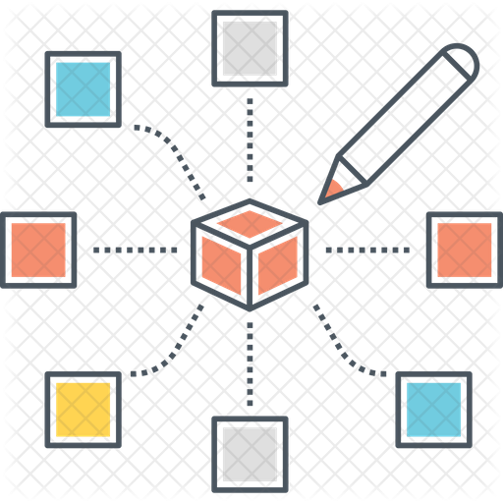
Algorithm Design
CE2103 - Algorithms and Data Structures II

Slide 2
Disclaimer / Descargo de Responsabilidad
Esta presentación corresponde a una guía usada por el profesor durante las clases. La misma ha sido modificada para ser utilizado en el modelo de cursos asistidos por tecnología. No es una versión final, por lo que la misma podría requerir todavía hacer algunos ajustes. Para aspectos de evaluación esta presentación es solo una guía, por lo que el estudiante debe profundizar con el material de lectura asignado y lo discutido en clases para aspectos de evaluación.
This presentation corresponds to a guide material used by the professor during classes. It has been modified to be used in the model of technology-assisted courses. It is not a final version, so it may still require some adjustments. For evaluation aspects, this presentation is only a guide, so the student should delve with the assigned reading material and what has been discussed in class.

Slide 3

What is design?
A plan or drawing produced to show the look and functions of an object before it is built
Purpose, planning or intention that exists behind an action, fact o material object.

Slide 4



Algorithm design process
This process involves a few significant steps:
Formulating the problem with enough mathematical precision. Concrete question and start thinking about algorithms to solve the problem.
Designing an algorithm for the problem.
Analyzing the algorithm to verify if it is correct and evaluate the algorithm’s efficiency.

Slide 5
Algorithm design process
This high-level strategy is carried out in practice with the help of a few fundamental design techniques
This process involves a few significant steps:
Formulating the problem with enough mathematical precision. Concrete question and start thinking about algorithms to solve the problem.
Designing an algorithm for the problem.
Analyzing the algorithm to verify if it is correct and evaluate the algorithm’s efficiency.

Slide 6
Algorithm design techniques
Are very useful in assessing the inherent complexity of a problem and in formulating an algorithm to solve it.
Becoming familiar with these design techniques is a gradual process.
With experience it is easy to associate the problems with categories.

Slide 7

Algorithm design techniques (Categories)
Divide and conquer
Backtracking
Dynamic programming
Heuristic algorithms
Genetic algorithms
Greedy algorithms
Probabilistics algorithms

Slide 8


Divide and Conquer

Slide 9
Divide and Conquer
STRATEGY
CHARACTERISTICS
Divide. Break the problem into several parts.
Conquer. Solves the problems in each part recursively.
Combine the solutions of subproblems into an overall solution.
Once the problem becomes small enough that we no longer recurse, we are at the base case.
Independent subproblems.
Recursive.
Very efficient.
Can be naturally parallelized.

Slide 10
Divide and Conquer
Simple, clear, robust and elegant. Ease of debugging and maintenance.
STRATEGY
CHARACTERISTICS
Divide. Break the problem into several parts.
Conquer. Solves the problems in each part recursively.
Combine the solutions of subproblems into an overall solution.
Once the problem becomes small enough that we no longer recurse, we are at the base case. .
Independent subproblems.
Recursive.
Very efficient.
Can be naturally parallelized.

Slide 11
Divide and Conquer
Longer execution time than iterative ones and complexity associated by the use of stack.
STRATEGY
CHARACTERISTICS
Divide. Break the problem into several parts.
Conquer. Solves the problems in each part recursively.
Combine the solutions of subproblems into an overall solution.
Once the problem becomes small enough that we no longer recurse, we are at the base case. .
Independent subproblems.
Recursive.
Very efficient.
Can be naturally parallelized.

Slide 12
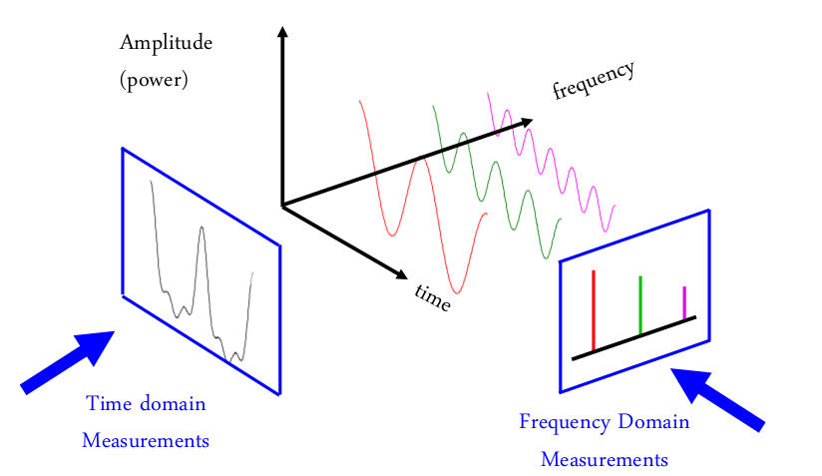
Divide and Conquer (Example)

Slide 13
Divide and Conquer (Example)
Sound signals are a non discrete and continuous function.

Slide 14
Divide and Conquer (Example)
This means is very hard to process by a computer.
Sound signals are a non discrete and continuous function.

Slide 15
Divide and Conquer (Example)
Fourier analysis allows to divide this continuous function into a set of frequencies that can be processed by a computer.
This means is very hard to process by a computer.
Sound signals are a non discrete and continuous function.

Slide 16
Divide and Conquer (Example)
This, in essence is a divide and conquer solution.
Fourier analysis allows to divide this continuous function into a set of frequencies that can be processed by a computer.
This means is very hard to process by a computer.
Sound signals are a non discrete and continuous function.

Slide 17
Divide and Conquer (Example)
Binary Search
Search value: 1
1 | 2 | 3 | 4 | 5 | 6 | 7 | 8 | 9 | 10 | 11
1 | 2 | 3 | 4 | 5
1 | 2

Slide 18
Divide and Conquer (Example)
Binary Search
01 02 03 04 05 06 07 08 09 10 11 12 13 14 15 | int binarySearch(double a[], double key, int lowEnd, int highEnd) { int middle; if (lowEnd > highEnd) { return -1; //Not found } else { middle = (lowEnd + highEnd) / 2; if (a[middle] == key) { return middle; } else if (a[middle] < key) { return binarySearch(a, key, middle + 1, highEnd); } else { return binarySearch(a, key, lowEnd, middle - 1); } }

Slide 19
Divide and Conquer (Example)
Mergesort
14 | 7 | 3 | 12 | 9 | 11 | 6 | 2
14 | 7 | 3 | 12
9 | 11 | 6 | 2
14 | 7
3 | 12
9 | 11
6 | 2
14
7
3
12
9
11
6
2

Slide 20
Divide and Conquer (Example)
Mergesort
14
7
3
12
9
11
6
2
7 | 14
3 | 12
9 | 11
2 | 6
3 | 7 | 12 | 14
2 | 6 | 9 | 11
2 | 3 | 6 | 7 | 9 | 11 | 12 | 14

Slide 21
Divide and Conquer (Example)
Mergesort
01 02 03 04 05 06 07 08 09 10 | void mergeSort(int *a, int low, int high) { int mid; if (low < high) { mid = (low + high) / 2; mergesort(a, low, mid); mergesort(a, mid + 1, high); merge(a, low, high, mid); } return; }

Slide 22
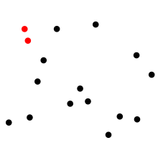
Divide and Conquer (Example)
Closest pair of points problem

Slide 23
Divide and Conquer (Example)
Closest pair of points problem
TRADITIONAL APPROACH

Slide 24
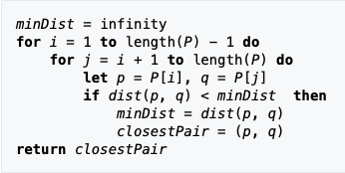
Divide and Conquer (Example)
Closest pair of points problem
FIRST APPROACH
DIVIDE AND CONQUER APPROACH

Slide 25
Divide and Conquer (Example)
Closest pair of points problem
FIRST APPROACH
DIVIDE AND CONQUER APPROACH
Sort the points according to their X coordinate.
If the set size is 2, return the distance between them. If the set has 0 or 1 elements, return ∞.
Divide the set of points into two equal parts (of the same number of points). Solve the problem recursively in the left and right parts.

Slide 26
Divide and Conquer (Example)
Other examples
Quicksort. The algorithm picks a pivot element, rearranges the array elements. All elements smaller than the picked pivot element move to left side of pivot, and all greater elements move to right side. Finally, the algorithm recursively sorts the subarrays on left and right of pivot element.
Strassen’s Algorithm. Algorithm to multiply two matrices.
Karatsuba Algorithm. Allows to compute the product of two large numbers using three multiplications of smaller numbers, each with about half as many digits as or, plus some additions and digit shifts.

Slide 27

Backtracking

Slide 28
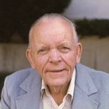
Backtracking (History)
The term “backtrack” was popularized by Derrick Henry Lehmer.
He was an american mathematician.
The language SNOBOL may have been the first to provide backtracking facility.
DERRICK HENRY LEHMER

Slide 29
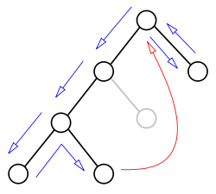
Backtracking
STRATEGY
STRATEGY (CONTINUE)
Is a methodical way of trying out various sequences of decisions, until you find one that works.
You can see the possible solutions as a tree.
Problem space consists of states (nodes) and actions (paths that lead to new states). When in a node can can only see paths to connected nodes
If a node only leads to failure go back to its "parent"node. Try other alternatives. If these all lead to failure then more backtracking may be necessary

Slide 30
Backtracking
STRATEGY
CHARACTERISTICS
Is a methodical way of trying out various sequences of decisions, until you find one that works.
You can see the possible solutions as a tree.
Systematically trying and eliminating possibilities.
Find all or some solutions.
Used extensively by languages like Prolog.
Naturally backtracking is a recursive algorithm.

Slide 31
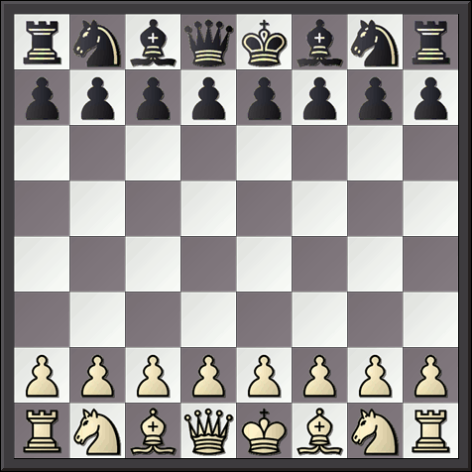
Backtracking (Example)
Eight Queens Problem
Place eight queens in a board in such a way that no queen interferes with another

Slide 32

Backtracking (Example)
Eight Queens Problem (Smaller version)

Slide 33
Backtracking (Example)
Eight Queens Problem (Smaller version)

Slide 34
Backtracking (Example)
That’s no good...backtrack
Eight Queens Problem (Smaller version)

Slide 35
Backtracking (Example)
Eight Queens Problem (Smaller version)

Slide 36
Backtracking (Example)
That’s no good...backtrack
Eight Queens Problem (Smaller version)

Slide 37
Backtracking (Example)
Eight Queens Problem (Smaller version)

Slide 38
Backtracking (Example)
Eight Queens Problem (Smaller version)

Slide 39
Backtracking (Example)
Eight Queens Problem (Smaller version)

Slide 40
Backtracking (Example)
Eight Queens Problem (Smaller version)

Slide 41
Backtracking (Example)
Eight Queens Problem (Smaller version)

Slide 42
Backtracking (Example)
Eight Queens Problem (Smaller version)

Slide 43
Backtracking (Example)
Eight Queens Problem (Smaller version)

Slide 44
Backtracking (Example)
Eight Queens Problem (Smaller version)

Slide 45
Backtracking (Example)
Eight Queens Problem (Smaller version)

Slide 46
Backtracking (Example)
Eight Queens Problem (Smaller version)

Slide 47
Backtracking (Example)
Eight Queens Problem (Smaller version)

Slide 48
Backtracking (Example)
Eight Queens Problem (Smaller version)

Slide 49
Backtracking (Example)
Eight Queens Problem (Smaller version)

Slide 50
Backtracking (Example)
Eight Queens Problem (Smaller version)

Slide 51
Backtracking (Example)
Eight Queens Problem (Smaller version)

Slide 52
Backtracking (Example)
92 possible solutions.
12 different solutions.
Eight Queens Problem (Smaller version)

Slide 53
Backtracking (Example)
Eight Queens Problem
01 02 03 04 05 06 07 08 09 10 11 12 13 14 15 | static boolean theBoardSolver(int board[][], int col) { if (col >= N) return true; for (int i = 0; i < N; i++) { if (toPlaceOrNotToPlace(board, i, col)) { board[i][col] = 1; if (theBoardSolver(board, col + 1)) return true; board[i][col] = 0; } } return false; }

Slide 54
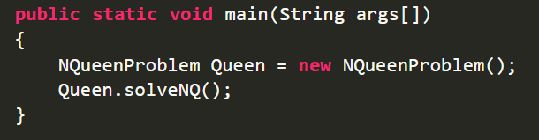
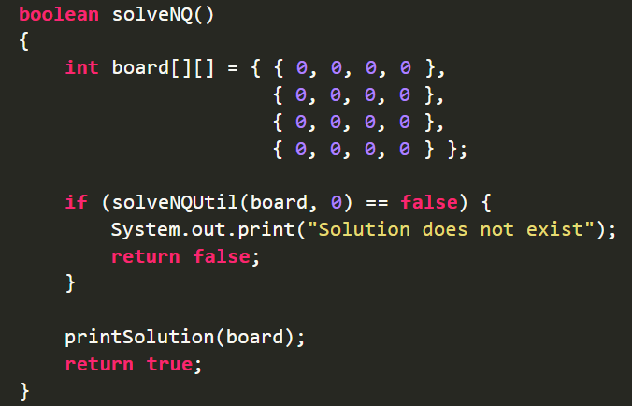

Slide 55
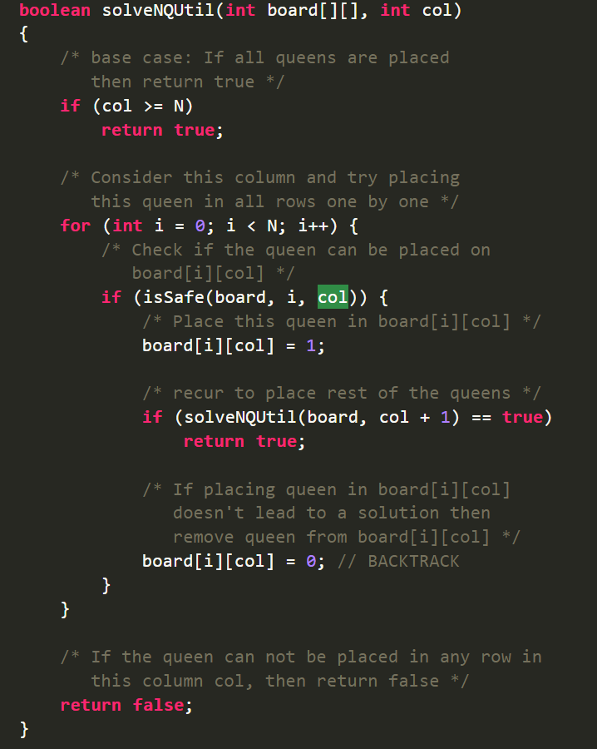

Slide 56
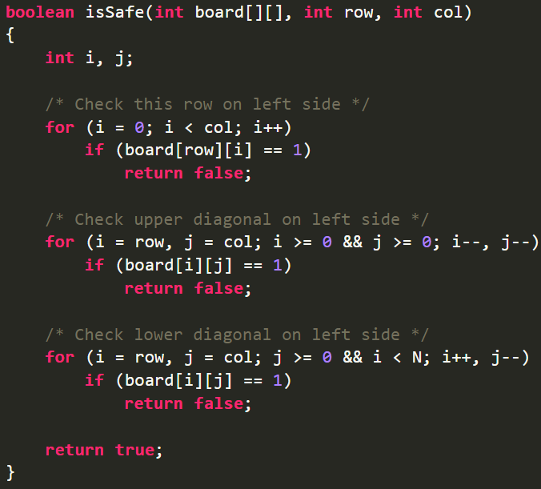

Slide 57
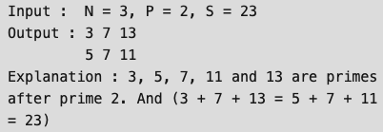
Backtracking (Example)
Prime numbers after prime P with sum S
DESCRIPTION
BACKTRACKING APPROACH
Given three numbers: sum S, prime P and N, find all N prime numbers after prime P such that their sum is equal to S

Slide 58
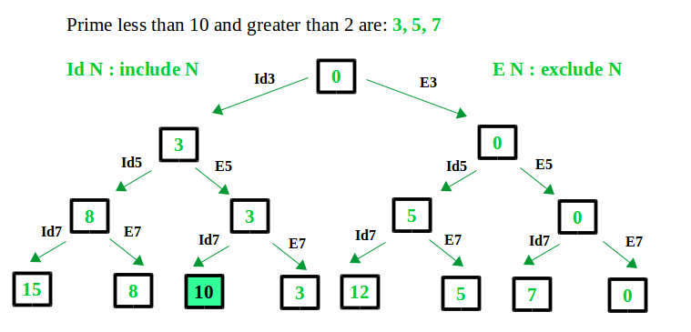
Backtracking (Example)
Prime numbers after prime P with sum S
DESCRIPTION
BACKTRACKING APPROACH
Given three numbers: sum S, prime P and N, find all N prime numbers after prime P such that their sum is equal to S

Slide 59
Backtracking (Example)
Other examples
The Knight’s Tour Problem. The knight is placed on the first block of an empty board and moving according to the rules of chess. Must visit each square exactly once.
Mazes. Find the way out in a maze.
Coloring Graph Problem. Given an undirected graph and a number m, determine if the graph can be colored with at most m colors such that no two adjacent vertices of the graph are colored with the same color.

Slide 60
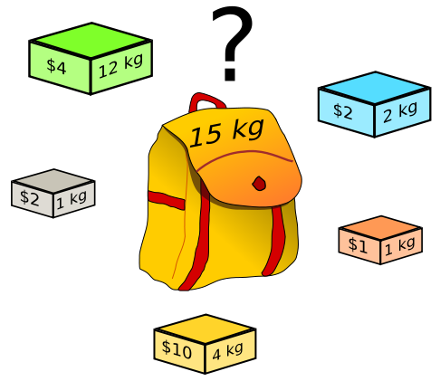
Dynamic Programming

Slide 61

Dynamic Programming (History)
Invented Dynamic Programming in the 1950s.
He was an american applied mathematician.
RICHARD E. BELLMAN

Slide 62
Dynamic Programming
STRATEGY
CHARACTERISTICS
Divide. Break the problem into several parts.
Conquer. Solves the problems in each part recursively.
Combine the solutions of subproblems into an overall solution.
Optimal substructure. Solution of a given optimization problem can be found by combination of optimal solutions to its subproblems.
Overlapping subproblems. The space of subproblems must be small, you have to solve the same subproblem over and over.
The principal difference between DyC and DP is… later. First, an example.

Slide 63
Dynamic Programming
STRATEGY
CHARACTERISTICS
Case of Fibonacci
Divide. Break the problem into several parts.
Conquer. Solves the problems in each part recursively.
Combine the solutions of subproblems into an overall solution.
Optimal substructure. Solution of a given optimization problem can be found by combination of optimal solutions to its subproblems.
Overlapping subproblems. The space of subproblems must be small, you have to solve the same subproblem over and over.
The principal difference between DyC and DP is… later. First, an example.

Slide 64
Dynamic Programming
STRATEGY
CHARACTERISTICS
Case of Fibonacci
Optimal substructure. Each solution to a sub problem is optimal, we have two base cases that are optimal (exact) fib(0) ad fib(1).
Overlapping subproblems. You have to calculate the same problem over and over, for example in the case of fib(10), you have to calculate fib(7) three times.
Divide. Break the problem into several parts.
Conquer. Solves the problems in each part recursively.
Combine the solutions of subproblems into an overall solution.
Optimal substructure. Solution of a given optimization problem can be found by combination of optimal solutions to its subproblems.
Overlapping subproblems. The space of subproblems must be small, you have to solve the same subproblem over and over.
The principal difference between DyC and DP is… later. First, an example.

Slide 65
Dynamic Programming
STRATEGY
CHARACTERISTICS
Case of Fibonacci
Optimal substructure. Each solution to a sub problem is optimal, we have two base cases that are optimal (exact) fib(0) ad fib(1).
Overlapping subproblems. You have to calculate the same problem over and over, for example in the case of fib(10), you have to calculate fib(7) three times.
Divide. Break the problem into several parts.
Conquer. Solves the problems in each part recursively.
Combine the solutions of subproblems into an overall solution.
Optimal substructure. Solution of a given optimization problem can be found by combination of optimal solutions to its subproblems.
Overlapping subproblems. The space of subproblems must be small, you have to solve the same subproblem over and over.
The principal difference between DyC and DP is… later. First, an example.

Slide 66
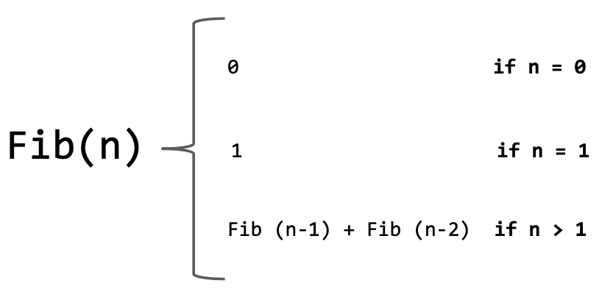
Dynamic Programming (Example)
Fibonacci

Slide 67
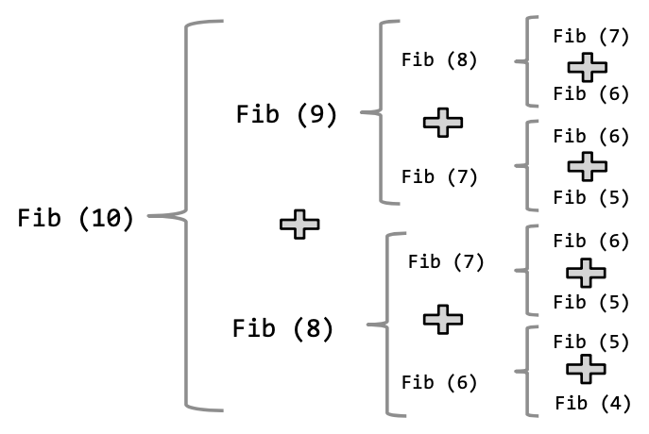
Dynamic Programming (Example)
Fibonacci

Slide 68
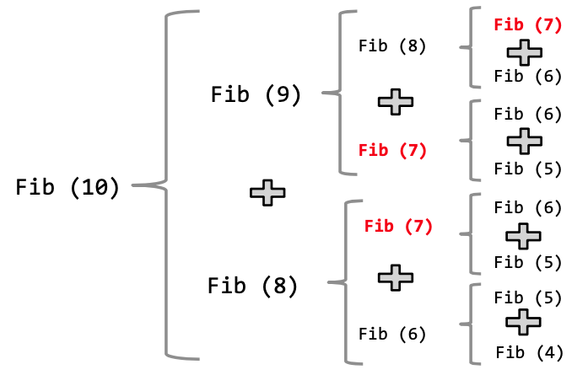
Dynamic Programming (Example)
Fibonacci
Reusable solutions

Slide 69
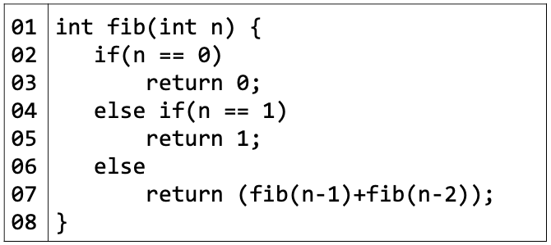
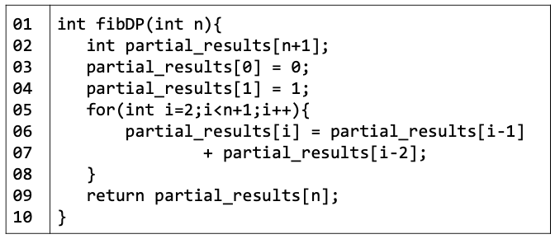
Dynamic Programming (Example)
Fibonacci
DIVIDE AND CONQUER APPROACH
DYNAMIC PROGRAMMING APPROACH

Slide 70
Dynamic Programming (Example)
Fibonacci
DIVIDE AND CONQUER APPROACH
DYNAMIC PROGRAMMING APPROACH
Difference?

Slide 71
Dynamic Programming (Example)
Fibonacci
DIVIDE AND CONQUER APPROACH
DYNAMIC PROGRAMMING APPROACH
Memoization. After computing a solution to a subproblem, store it in a table. Subsequent calls check the table to avoid redoing work

Slide 72
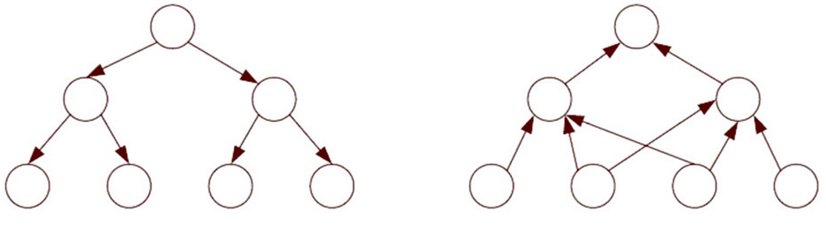
Dynamic Programming
Difference with Divide and Conquer
Divide and Conquer
Dynamic Programming

Slide 73
Dynamic Programming
Difference with Divide and Conquer
Divide and Conquer
Dynamic Programming
For example, in mergesort, each subproblem is different and doesn’t help solving other subproblems.

Slide 74
Dynamic Programming
Difference with Divide and Conquer
Divide and Conquer
Dynamic Programming
Each of these subproblems are similar between each other.

Slide 75
Dynamic Programming
Difference with Divide and Conquer
Divide and Conquer
Dynamic Programming
Solve a subproblem helps to solve other subproblems.

Slide 76
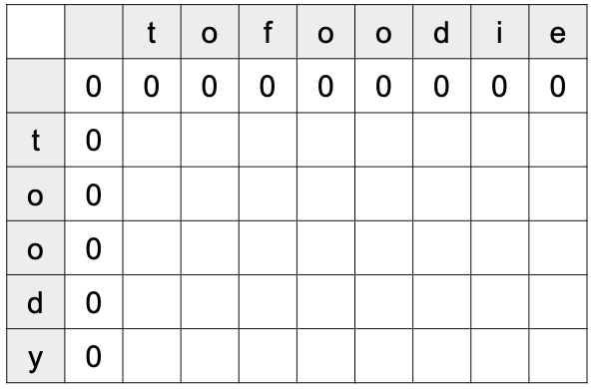
Dynamic Programming (Example)
Find the longest common substring
DESCRIPTION
DYNAMIC PROGRAMMING APPROACH
Let s = “tofoodie” and t = “toody”
Let D[i,j] be the length of the longest matching string between substrings s₁...s_{i} and the substring of t between t₁...t_{j}
D[i,j] = 0 if s[i] <> t[j]
D[i-1,j-1] + 1 if s[i] == t[j]

Slide 77
Dynamic Programming (Example)
Find the longest common substring
No matches on empty strings
DESCRIPTION
DYNAMIC PROGRAMMING APPROACH
Let s = “tofoodie” and t = “toody”
Let D[i,j] be the length of the longest matching string between substrings s₁...s_{i} and the substring of t between t₁...t_{j}
D[i,j] = 0 if s[i] <> t[j]
D[i-1,j-1] + 1 if s[i] == t[j]

Slide 78
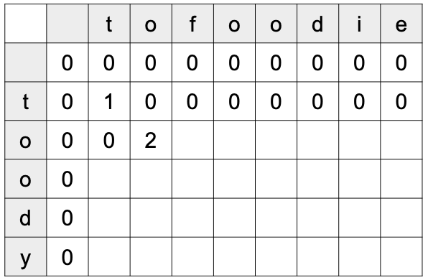
Dynamic Programming (Example)
Find the longest common substring
DESCRIPTION
DYNAMIC PROGRAMMING APPROACH
Let s = “tofoodie” and t = “toody”
Let D[i,j] be the length of the longest matching string between substrings s₁...s_{i} and the substring of t between t₁...t_{j}
D[i,j] = 0 if s[i] <> t[j]
D[i-1,j-1] + 1 if s[i] == t[j]

Slide 79
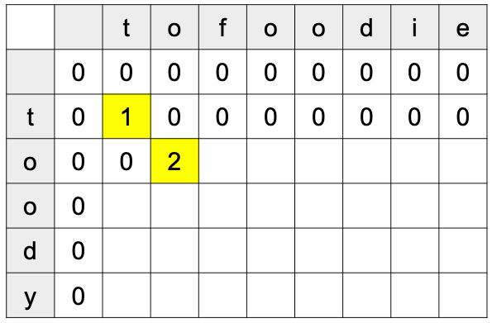
Dynamic Programming (Example)
Find the longest common substring
DESCRIPTION
DYNAMIC PROGRAMMING APPROACH
D [ i - 1, j - 1 ] + 1
Let s = “tofoodie” and t = “toody”
Let D[i,j] be the length of the longest matching string between substrings s₁...s_{i} and the substring of t between t₁...t_{j}
D[i,j] = 0 if s[i] <> t[j]
D[i-1,j-1] + 1 if s[i] == t[j]

Slide 80
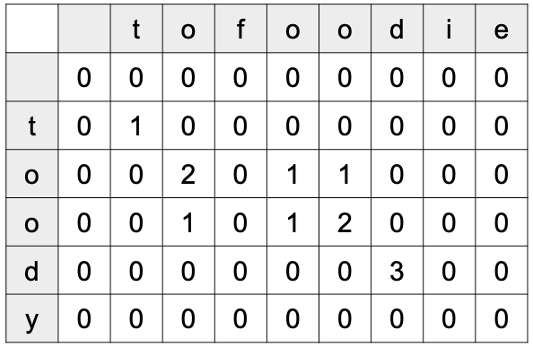
Dynamic Programming (Example)
Find the longest common substring
DESCRIPTION
DYNAMIC PROGRAMMING APPROACH
Let s = “tofoodie” and t = “toody”
Let D[i,j] be the length of the longest matching string between substrings s₁...s_{i} and the substring of t between t₁...t_{j}
D[i,j] = 0 if s[i] <> t[j]
D[i-1,j-1] + 1 if s[i] == t[j]

Slide 81
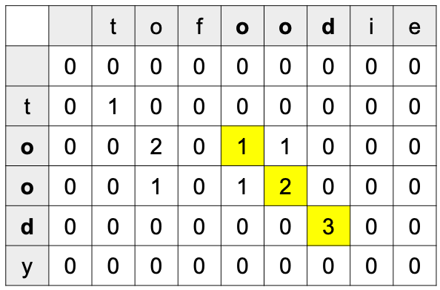
Dynamic Programming (Example)
Find the longest common substring
LCS
DESCRIPTION
DYNAMIC PROGRAMMING APPROACH
Let s = “tofoodie” and t = “toody”
Let D[i,j] be the length of the longest matching string between substrings s₁...s_{i} and the substring of t between t₁...t_{j}
D[i,j] = 0 if s[i] <> t[j]
D[i-1,j-1] + 1 if s[i] == t[j]
Largest value found

Slide 82
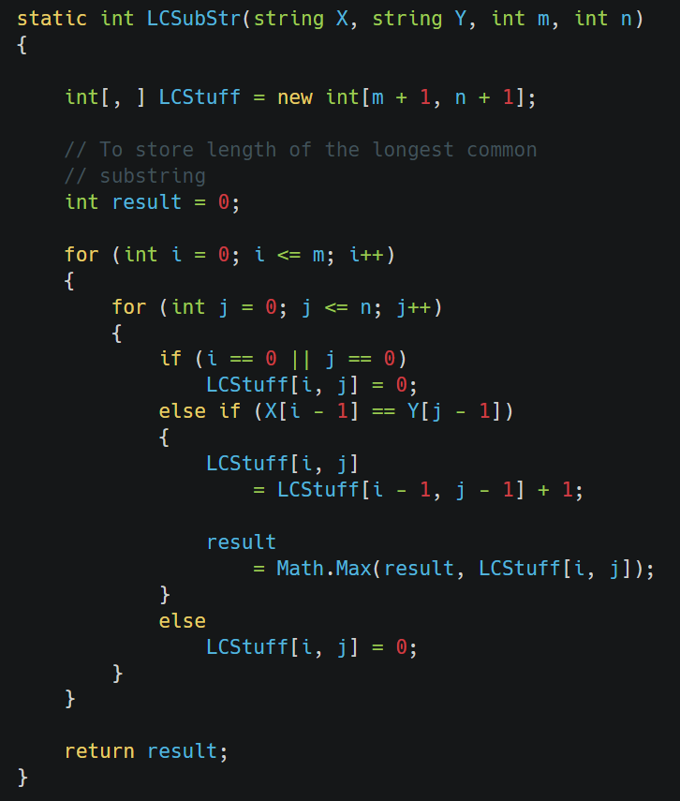
Dynamic Programming (Example)
Find the longest common substring. For example, for “abcdxyz” and “xyzabcd”, the result would be “abcd”
COMMON APPROACH
DYNAMIC PROGRAMMING APPROACH

Slide 83
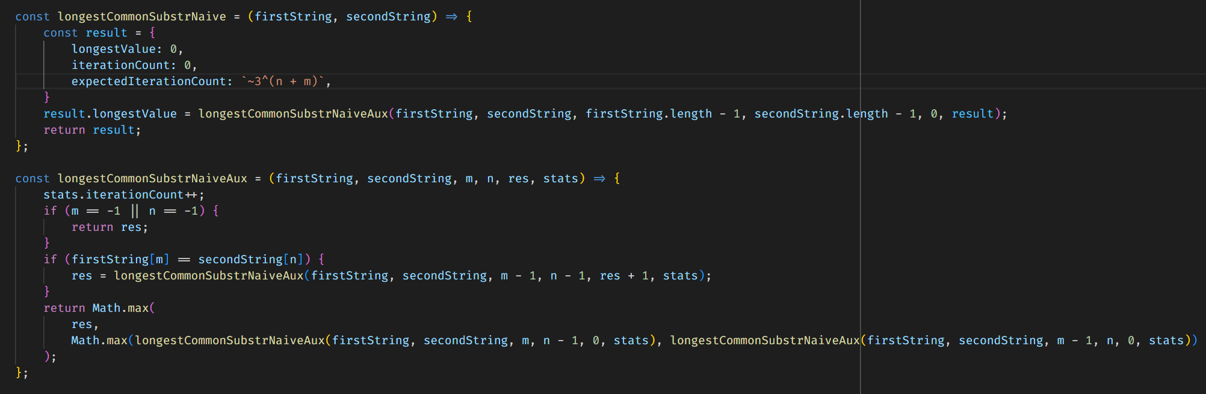
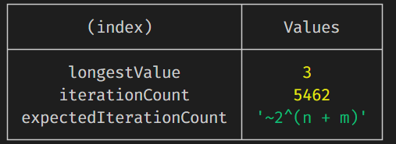
Dynamic Programming (Example)
COMMON APPROACH
To calculate this, we need to generate the recursion tree

Slide 84
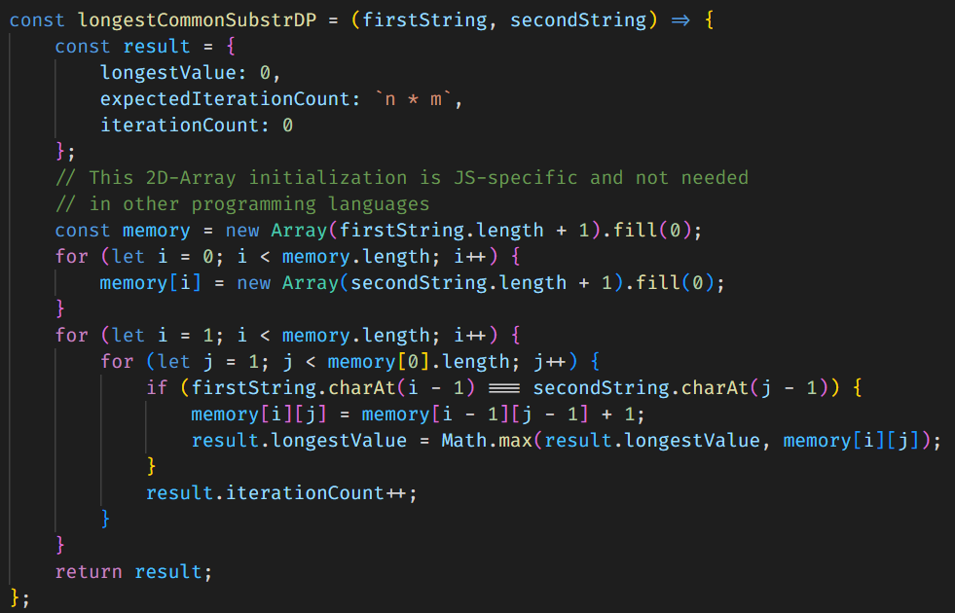
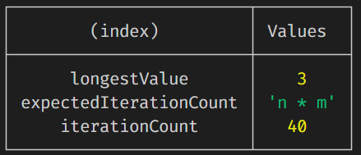
Dynamic Programming (Example)
DYNAMIC PROGRAMMING APPROACH

Slide 85

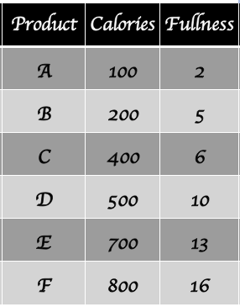
Dynamic Programming (Example)
Knapsack Problem
Have to choose the right food for you. Only can eat 800 calories by day and have to maximize the fullness sensation

Slide 86
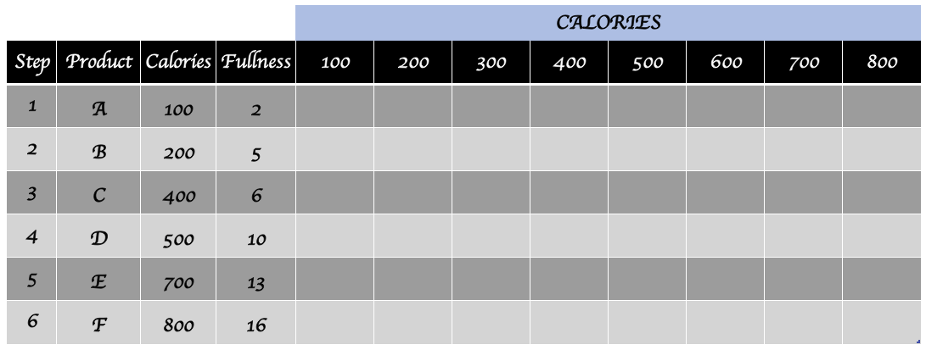
Dynamic Programming (Example)
Knapsack Problem

Slide 87
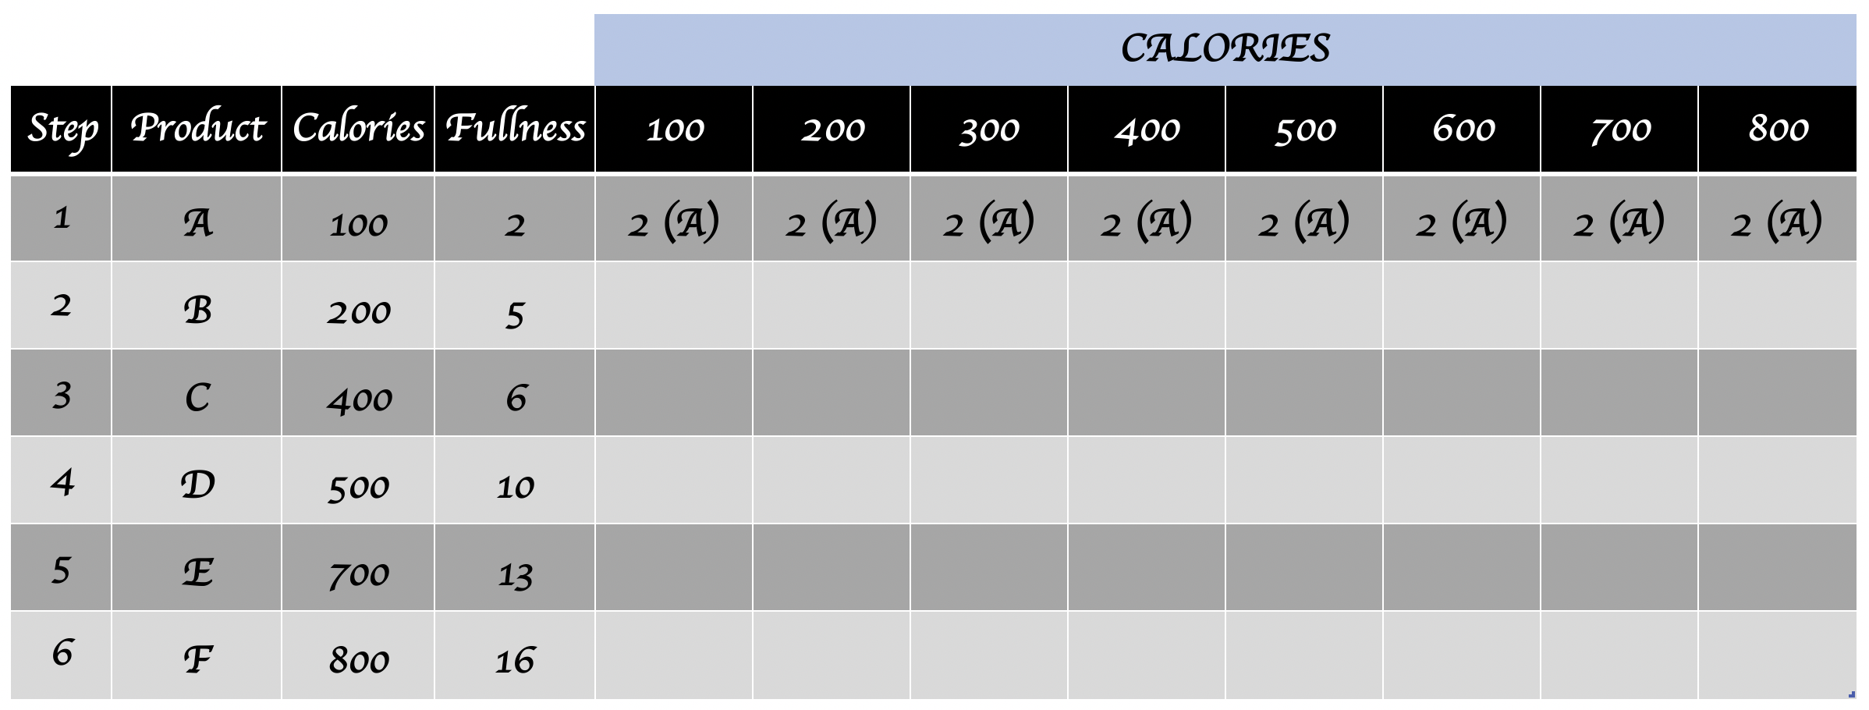
Dynamic Programming (Example)
Knapsack Problem

Slide 88
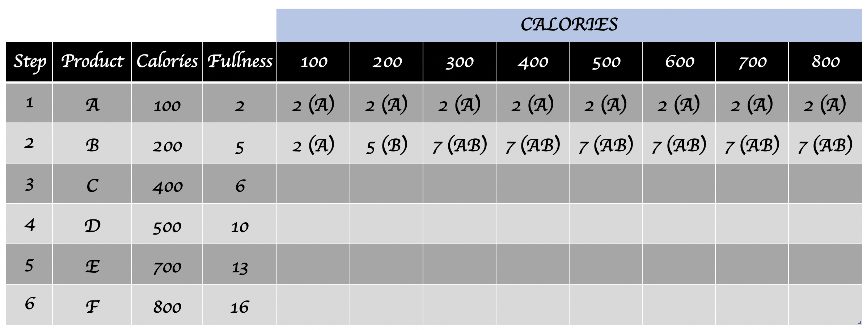
Dynamic Programming (Example)
Knapsack Problem

Slide 89
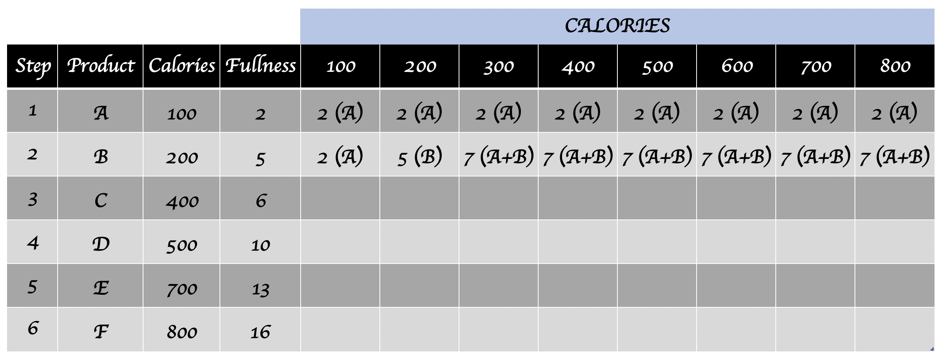
Dynamic Programming (Example)
Knapsack Problem

Slide 90
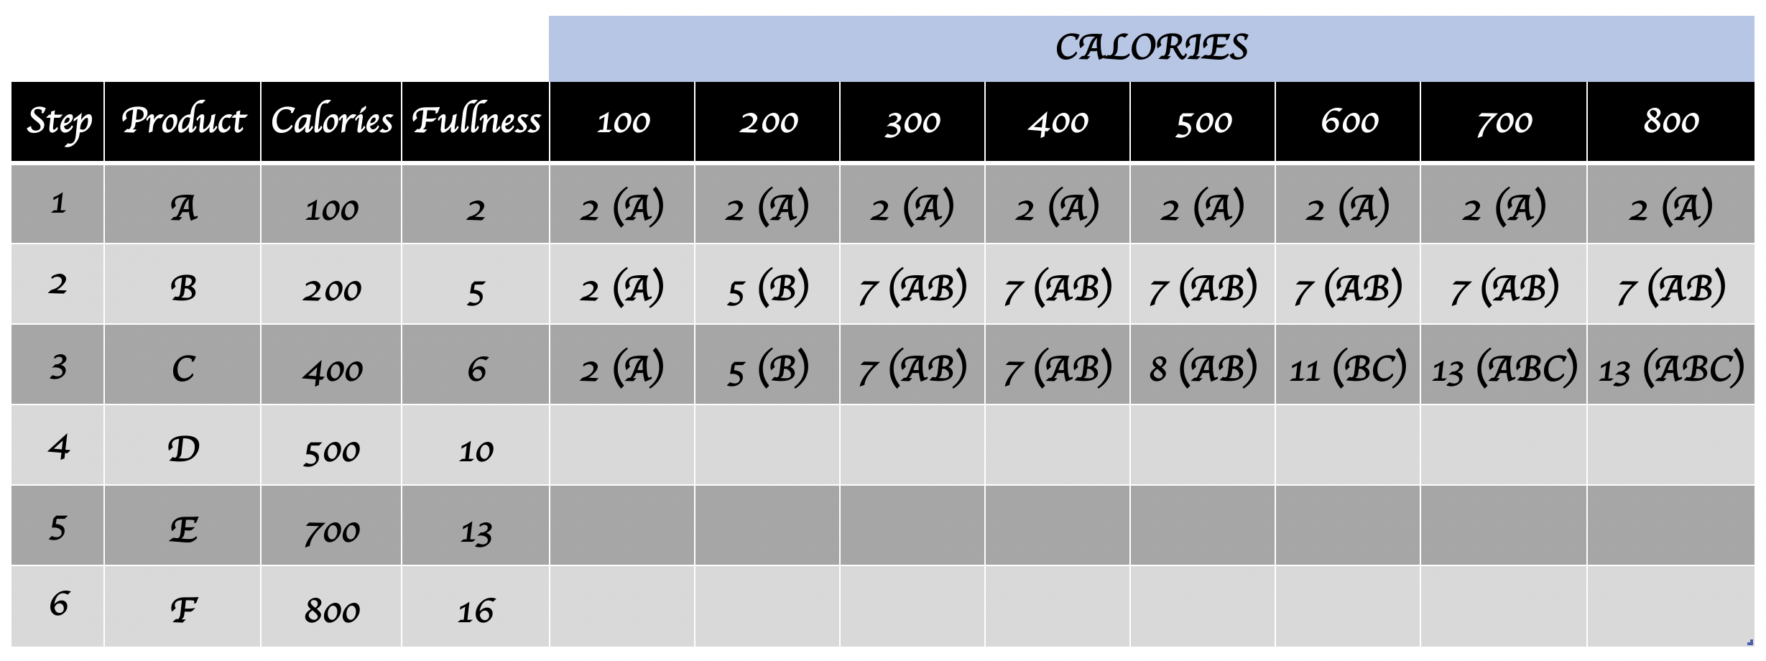
Dynamic Programming (Example)
Knapsack Problem

Slide 91
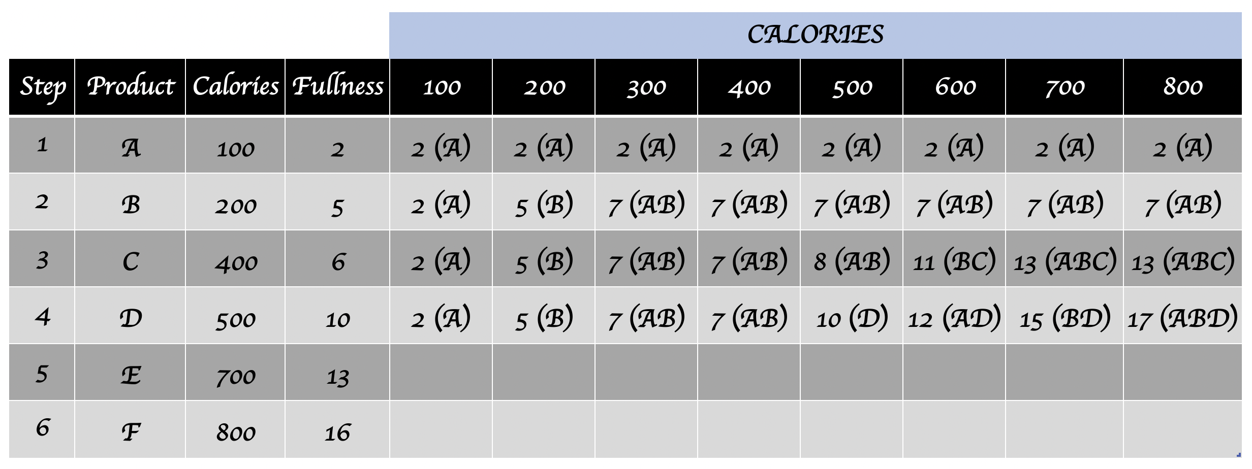
Dynamic Programming (Example)
Knapsack Problem

Slide 92
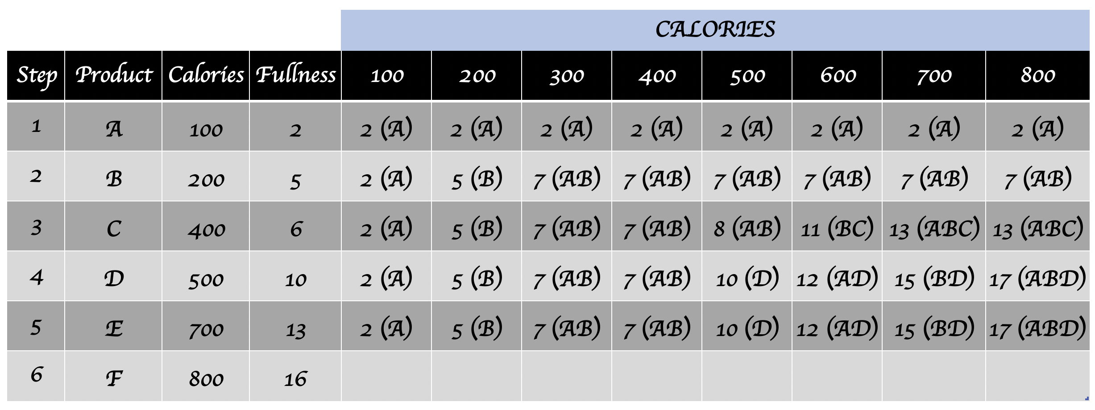
Dynamic Programming (Example)
Knapsack Problem
Why no changes on this step?

Slide 93
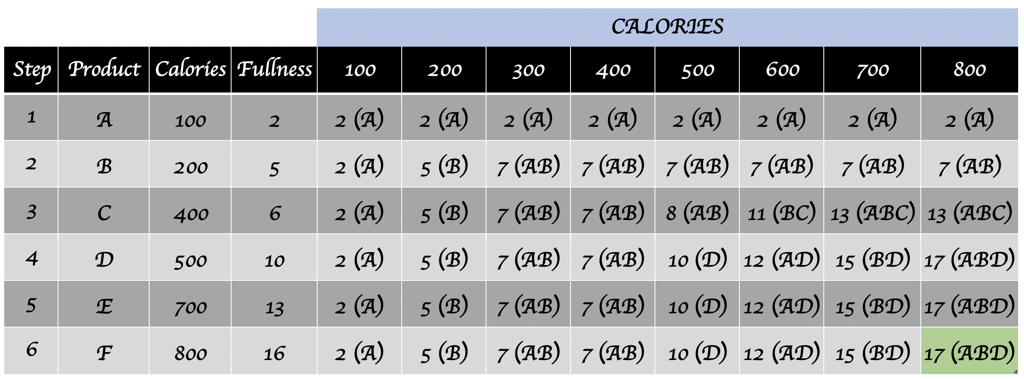
Dynamic Programming (Example)
Knapsack Problem
This is the best option to get 800 calories and maximice fullness sensation

Slide 94

Dynamic Programming (Example)
Cashier Problem
For a specific amount give the least amount of units of the different denominations.

Slide 95
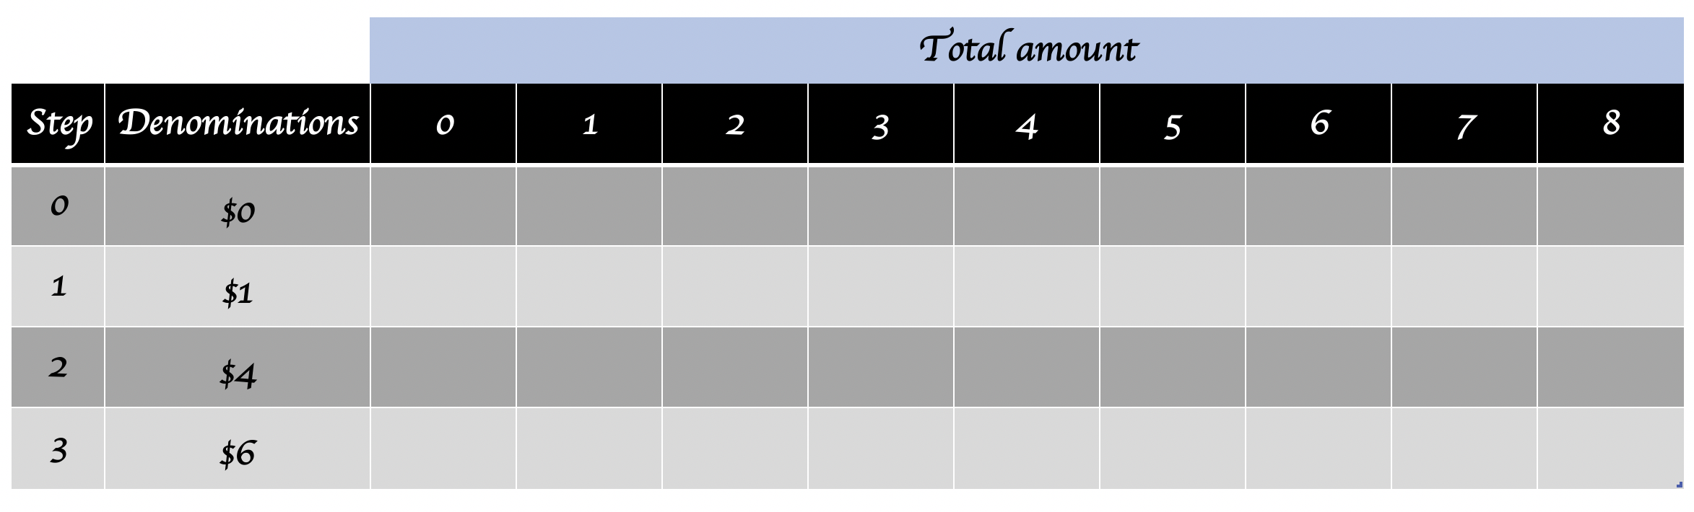
Dynamic Programming (Example)
Cashier Problem

Slide 96
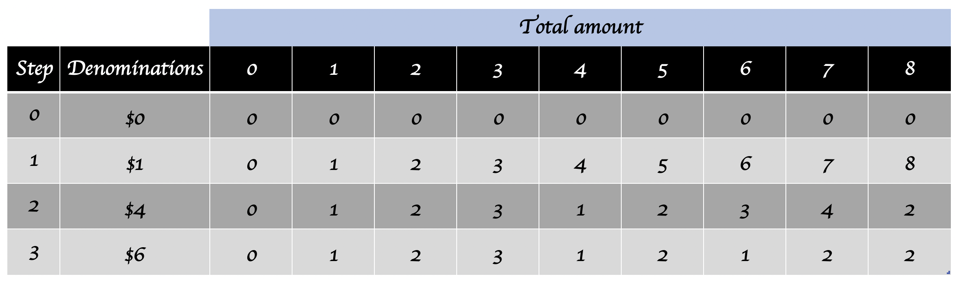
Dynamic Programming (Example)
Cashier Problem

Slide 97
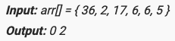
Dynamic Programming (Example)
Other examples
Ugly numbers. Given a number n, find n Ugly numbers. Ugly numbers are numbers whose only prime factors are 2, 3 or 5. The number 1 is included by convention. The sequence 1, 2, 3, 4, 5, 6, 8, 9, 10, 12, 15 shows the first 11 ugly numbers.
Min Cost Path. Given a cost matrix and a position, calculate the cost of minimum cost path form position (0,0) to the input position. Each cell of the matrix represents a cost to traverse through that cell.
Longest Common Subsequence of three strings.
Index of elements which are equal to the sum of all succeeding elements

Slide 98
Different approaches to the same problem
There are problems that can be addressed with different approaches.
For example, knapsack problem can be solved using:
Dynamic Programming (recently seen).
Backtracking (your responsibility).
Genetic algorithms (more on this later).

Slide 99
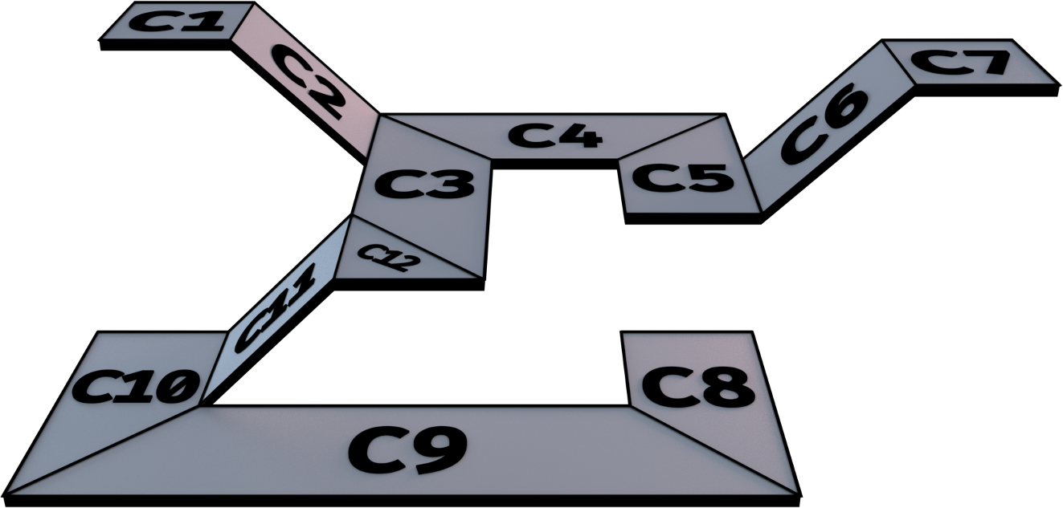
Heuristic Algorithms

Slide 100
Heuristic Algorithms
Algorithms that find solutions that are guaranteed to be close to optimal.
Scenarios where precision can be sacrificed for performance.
Also called approximate algorithms.
Examples of heuristic algorithms:
Genetic algorithms.
Greedy algorithms.

Slide 101

Genetic Algorithms

Slide 102
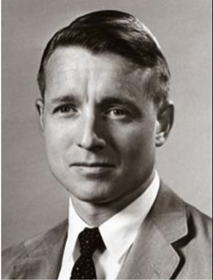
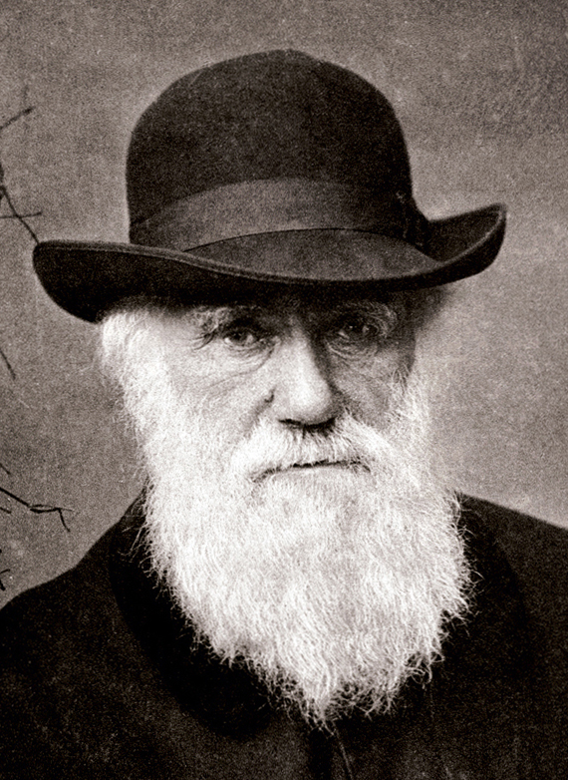
Genetic Algorithms
In the 50’s and 60’s computer scientists studied evolutionary systems with the idea of use them as a tool to optimize engineering problems.
Inspired by biological evolution process and based on concepts like: natural selection, genetic inheritance and mutations.
Developed by
(1970s)
Based on theory of
(1859)
JOHN HENRY HOLLAND
CHARLES DARWIN

Slide 103
Genetic Algorithms
Genetic Algorithms (GAs) are adaptive heuristic search algorithm based on the evolutionary ideas of natural selection and genetics.
They represent an intelligent exploitation of a random search used to solve optimization problems.
Not entirely random. They exploit historical information to direct the search
This simulate the natural selection process. Use techniques inspired by evolutionary biology such as inheritance, mutation, selection, and recombination.

Slide 104
Genetic Algorithms
HAVE TO BE DEFINED
DEFINITIONS
Genetic representation of the solution domain.
Fitness function to evaluate the solution domain.
Cell. Contains chromosomes (string DNA). .
Chromosomes. Set of genes (blocks DNA). Scheme or blueprint for an individual.
Genotype. Collection of genes responsible for a particular trait.
Trait. Aspect of an individual.

Slide 105
Genetic Algorithms
HAVE TO BE DEFINED
DEFINITIONS
Genetic representation of the solution domain.
Fitness function to evaluate the solution domain.
Reproduction. Combination of parental genes.
Mutation. Errors during reproduction.
Individual. Any possible solution. .
Fitness. Function used to select the best individuals. How many times can an individual reproduce before dying.

Slide 106
Genetic Algorithms
HAVE TO BE DEFINED
DEFINITIONS
Genetic representation of the solution domain.
Fitness function to evaluate the solution domain.
Population. Group of all individuals.
Search space. All the possible solutions for a problem. .
Genome. Collection of chromosomes for an individual.

Slide 107
Genetic Algorithms (Representation of solutions)
Typical representation of a solution is an array of bits (Bit Vectors).
Try to use a fixed length representation, will facilitate the crossover.
Initially we solve the knapsack problem using Dynamic Programming, but... What happens if we try to use genetic algorithms?

Slide 108
Genetic Algorithms (Representation of solutions)
Knapsack Problem (Using Genetic Algorithms)
1 | 1 | 1 | 0 | 0 | 1 | 0 | 1 | 1 | 0 | 0 | 0 | 0 | 1 | 0 | 1
0 | 1 | 2 | 3 | 4 | 5 | 6 | 7 | 8 | 9 | 10 | 11 | 12 | 13 | 14 | 15
Sweet Cookies
Apple
Integral Cookies
Hamburguer
Salad + Chicken
Chocolat Bar
Chicken and Rice
Rice and Beans + Eggs
0 = don't choose this product
1 = choose this product

Slide 109
Genetic Algorithms (Representation of solutions)
Bit Vectors
Specialized type to work with bit arrays (boolean values).
No waste of space.
There is not type “bit” in the programming languages, we work with bigger types to represent a bit array (bytes).
Save space when we are going to transfer data over the network. Efficient use of resources.
Used to compress data and encryption algorithms.

Slide 110
Genetic Algorithms (Representation of solutions)
Bit Vectors
Specialized type to work with bit arrays (boolean values).
No waste of space.
There is not type “bit” in the programming languages, we work with bigger types to represent a bit array (bytes).
Save space when we are going to transfer data over the network. Efficient use of resources.
Used to compress data and encryption algorithms.
You can represent a Bit Vector as follows:
int bit_vector = 0;

Slide 111
Genetic Algorithms (Representation of solutions)
Bit Vectors
Specialized type to work with bit arrays (boolean values).
No waste of space.
There is not type “bit” in the programming languages, we work with bigger types to represent a bit array (bytes).
Save space when we are going to transfer data over the network. Efficient use of resources.
Used to compress data and encryption algorithms.
This give you a bit vector of 32 positions (4 bytes). Use bitwise operations to perform operations.
You can represent a Bit Vector as follows:
int bit_vector = 0;

Slide 112
Genetic Algorithms (Fitness)
Defined over the genetic representation.
Measures the quality of a given solution.
Defines which solutions have more probabilities of survive and reproduce.

Slide 113
Genetic Algorithms (Fitness)
Knapsack Problem (Using Genetic Algorithms)
fitness(solution) = fullness(solution) + calories(solution)
fullness(solution) = sum(fullness of each item in the solution)
------------------------------------------------------------------
sum(fullness all the possible items)
calories(solution) =
x = abs(sum(calories of each item in the solution) - 2000)
if (x == 0)
x = 1
x = 2000/x

Slide 114
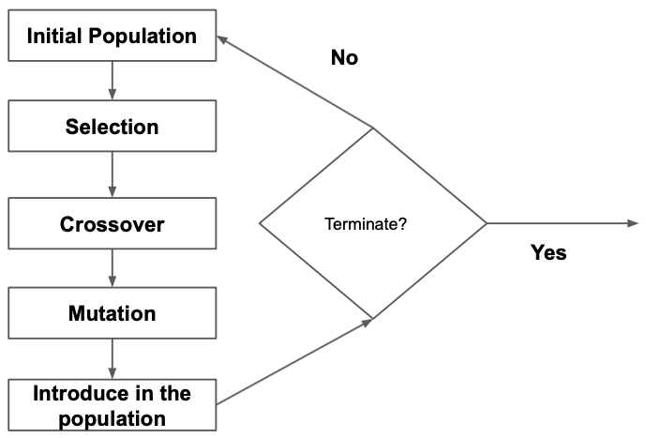
Genetic Algorithms
STRATEGY
GENERAL DESCRIPTION
Evolution starts with a random population, this is called first generation.
In each generation, fitness of every individual is calculated.
Several individuals are selected from the current population based on their fitness.
These individuals are combined to obtain new individuals.
Some individuals are discarded from the new population (lowest fitness).
At the end of each iteration we have a new population (new generation) that will be used in the next iteration.

Slide 115
Genetic Algorithms
STRATEGY
GENERAL DESCRIPTION
Evolution starts with a random population, this is called first generation.
In each generation, fitness of every individual is calculated.
Several individuals are selected from the current population based on their fitness.
These individuals are combined to obtain new individuals.
Some individuals are discarded from the new population (lowest fitness).
At the end of each iteration we have a new population (new generation) that will be used in the next iteration.
When does a genetic algorithm end?

Slide 116
Genetic Algorithms
STRATEGY
GENERAL DESCRIPTION
Evolution starts with a random population, this is called first generation.
In each generation, fitness of every individual is calculated.
Several individuals are selected from the current population based on their fitness.
These individuals are combined to obtain new individuals.
Some individuals are discarded from the new population (lowest fitness).
At the end of each iteration we have a new population (new generation) that will be used in the next iteration.
iteration.
When does a genetic algorithm end?
Reach a maximum number of generations.
There is no change in the genetic material of the population
Both cases: A suitable solution may or may not have reached.

Slide 117
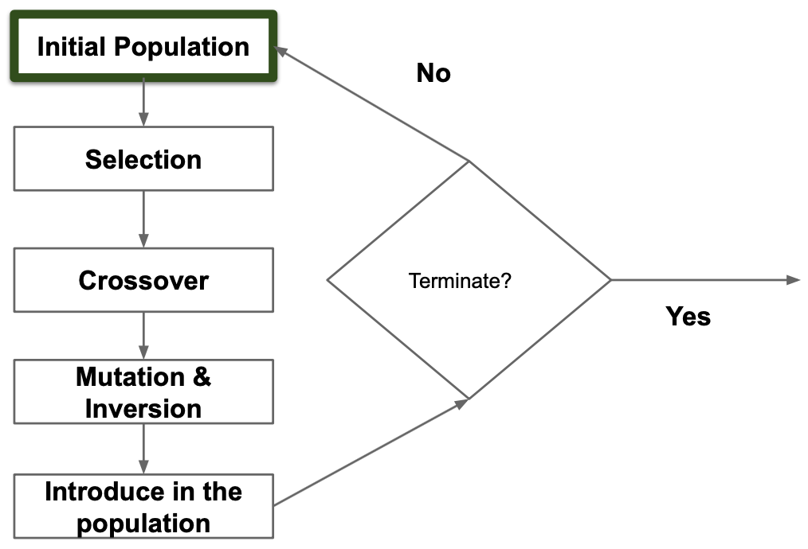
Genetic Algorithms
INITIAL POPULATION
STRATEGY
Randomly generated, covering the entire search space.
Population size depends on the problem (usually has several hundreds or thousands).
Solution may be seeded in areas where optimal solutions can be found.
An small population can give you a local maximum. A huge population requires too much computational resources.

Slide 118
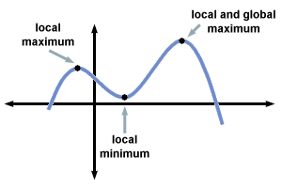
Genetic Algorithms
INITIAL POPULATION
STRATEGY
Randomly generated, covering the entire search space.
Population size depends on the problem (usually has several hundreds or thousands).
Solution may be seeded in areas where optimal solutions can be found.
An small population can give you a local maximum. A huge population requires too much computational resources.

Slide 119
Genetic Algorithms
INITIAL POPULATION
STRATEGY
Randomly generated, covering the entire search space.
Population size depends on the problem (usually has several hundreds or thousands).
Solution may be seeded in areas where optimal solutions can be found.
An small population can give you a local maximum. A huge population requires too much computational resources.
Solution may never be found

Slide 120
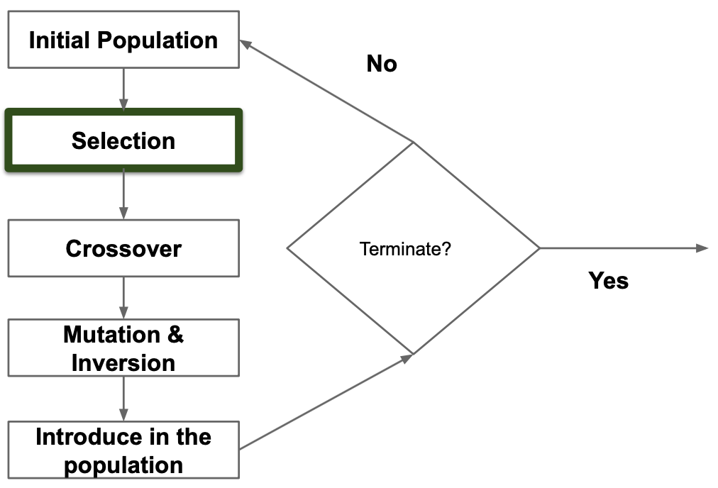
Genetic Algorithms
STRATEGY
SELECTION
During each generation you select a part of the population to create a new generation.
Individuals are selected based on their fitness (proportional to the fitness).
There are other methods to select individuals, for example, random.

Slide 121
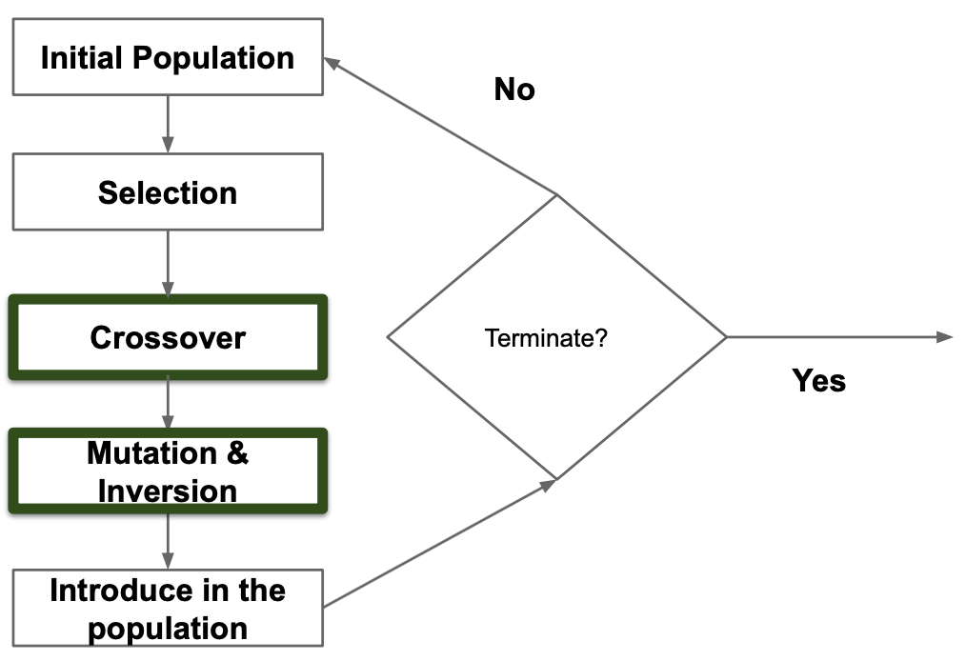

Genetic Algorithms
REPRODUCTION
STRATEGY
Crossover, mutation and inversion.
For each new solution, select a pair of parents (proportional to their fitness).
Crossover:

Slide 122
Genetic Algorithms
REPRODUCTION
STRATEGY
Mutation (low probability) and Inversion (very low probability).
In the mutation we select a random bit and add 1, discard the overflow.
In the inversion select a random chain of bits and apply complement to this chain.

Slide 123

Genetic Algorithms
REPRODUCTION
STRATEGY

Slide 124
Genetic Algorithms (Example)
Other examples
Travelling Salesman Problem. Given a collection of cities, determine the minimum cost route, visiting each city exactly once and returning to the starting point.
Cashier Problem. The same used in Dynamic Programming.

Slide 125

Greedy Algorithms

Slide 126
Greedy Algorithms
STRATEGY
CHARACTERISTICS
Builds up a solution in small steps, choosing a decision at each step.
A greedy algorithm always makes the choice that looks better at the moment. Makes a locally optimal choice in the hope that this choice will lead to a global optimal solution.
In some cases it doesn’t provide an optimal solution.
It can approximate an optimal solution.
Optimal solution depends on an heuristic function.
It is fast.

Slide 127


Greedy Algorithms
OPTIMAL SOLUTION
GREEDY

Slide 128
Greedy Algorithms
STRATEGY
STRATEGY
A candidate set from which a solution is created.
A selection function, which chooses the best candidate to be added to the solution.
A feasibility function, that is used to determine if a candidate can be used to contribute to a solution.
An objective function which assigns a value to a solution or a partial solution.
A solution function which will indicate when we have discovered a complete solution.

Slide 129


Greedy Algorithms (Examples)
Dijkstra Algorithm
Find the shortest path from A to every other vertex

Slide 130

Greedy Algorithms (Examples)
Dijkstra Algorithm

Slide 131

Greedy Algorithms (Examples)
Dijkstra Algorithm

Slide 132

Greedy Algorithms (Examples)
Dijkstra Algorithm

Slide 133

Greedy Algorithms (Examples)
Dijkstra Algorithm

Slide 134

Greedy Algorithms (Examples)
Dijkstra Algorithm

Slide 135

Greedy Algorithms (Examples)
Dijkstra Algorithm

Slide 136

Greedy Algorithms (Examples)
Dijkstra Algorithm

Slide 137

Greedy Algorithms (Examples)
Dijkstra Algorithm

Slide 138
Greedy Algorithms (Examples)
Dijkstra Algorithm
The shortest path from A to G is:
A -> C -> F -> G

Slide 139

Greedy Algorithms (Examples)
Dijkstra Algorithm
Find the shortest path from A to every other vertex

Slide 140

Greedy Algorithms (Examples)
Dijkstra Algorithm

Slide 141
Greedy Algorithms (Examples)
Find largest sum
7
3
12
99
8
5
6

Slide 142
Greedy Algorithms (Examples)
Find largest sum
Greedy will find this solution
7
3
12
99
8
5
6

Slide 143
Greedy Algorithms (Examples)
But this is the best solution...
Find largest sum
7
3
12
99
8
5
6

Slide 144

Greedy Algorithms (Example)
Cashier Algorithm
CASE
SOLUTION
475 (100,50,25,10)
279 (100,50,25,10,1)
7 (1,3,4,5)

Slide 145

Greedy Algorithms (Example)
Cashier Algorithm
CASE
SOLUTION
475 (100,50,25,10)
279 (100,50,25,10,1)
7 (1,3,4,5)

Slide 146

Greedy Algorithms (Example)
Cashier Algorithm
But this is the best solution...
CASE
SOLUTION
475 (100,50,25,10)
279 (100,50,25,10,1)
7 (1,3,4,5)

Slide 147
Greedy Algorithms (Example)
Other examples
Kruskal and Prim Minimum Spanning Tree. Both algorithms creates a Minimum Spanning Tree by picking edges one by one. The difference is the criterion for selecting the edge.
Huffman Coding. Is a loss-less compression technique (more on this later).
Traveling Salesman Problem. Given a collection of cities, determine the minimum cost route, visiting each city exactly once and returning to the starting point.

Slide 148

Probabilistic Algorithms

Slide 149
Probabilistic Algorithms
Algorithms that uses random numbers to decide what to do next.
Finding the optimal solution requires too much time or resources.
Even with the same input, the algorithm behavior will vary on each execution. Running time and result may vary too.

Slide 150


Probabilistic Algorithms
Probabilistic vs Deterministic
Could fail or never end running as long as the probability for those events is too low.
Can find different solutions for the same input
Even if an algorithm is deterministic, that does not guarantee that the solution is accurate, why?

Slide 151
Probabilistic Algorithms
Probabilistic vs Deterministic
Could fail or never end running as long as the probability for those events is too low.
Can find different solutions for the same input
Even if an algorithm is deterministic, that does not guarantee that the solution is accurate, why?
Hardware failure

Slide 152
Probabilistic Algorithms
Categories
LAS VEGAS
MONTE CARLO
These algorithms always produce correct or optimum results.
If not find the correct answer report the failure.
Produce correct or optimum result with some probability.
May return an answer that is not correct.

Slide 153
Probabilistic Algorithms (Example)
Other examples
Hashing.
Sorting.
Searching.
Load Balancing.
Minimum spanning trees.
Shortest paths.

Slide 154
Some thoughts on web development
What is a web page?
What is a web application?
What are the components of a web application?
What is client-side?
What is server-side?
Geek Corner

Slide 155
Some thoughts on web development
Ajax?
Web frameworks? Toolkits?
Web server?
Web application server?
Geek Corner

Slide 156
Some thoughts on web development
A web page is any document that is suitable for the world wide web and a web browser
A web page is written in some kind of code (HTML, XML, JS) that the browser can parse and render to the user
You can talk of static pages which the content is static and cannot change unless you edit the actual page
Dynamic pages can change the content depending of some logic. These are generated by the server
Geek Corner

Slide 157
Some thoughts on web development
A web application is software. Software that can run on a web browser.
As any other well-written software application, a web application is composed of layers:
Presentation or UI layer.
Business or logic layer.
Data layer.
To run the complete application, many components are needed:
Browser
DB server
Application server and optionally web server.
Geek Corner

Slide 158
Some thoughts on web development
Geek Corner
Browser
Web Application Server
Database Server
Web Server

Slide 159
Some thoughts on web development
Most of the time the web server is embedded inside the application server
Geek Corner
Browser
Web Application Server
Database Server
Web Server

Slide 160
Some thoughts on web development
Geek Corner
Browser
Web Application Server
Database Server
Web Server

Slide 161
Some thoughts on web development
Geek Corner
Browser Mozilla
Web Application Server
Glassfish
Database Server
DB2
Web Server
Apache

Slide 162
Some thoughts on web development
Presentation Layer
Geek Corner
Browser Mozilla
Web Application Server
Glassfish
Database Server
DB2
Web Server
Apache

Slide 163
Some thoughts on web development
Business or Logic Layer
Geek Corner
Browser Mozilla
Web Application Server
Glassfish
Database Server
DB2
Web Server
Apache

Slide 164
Some thoughts on web development
Data Layer
Geek Corner
Browser Mozilla
Web Application Server
Glassfish
Database Server
DB2
Web Server
Apache

Slide 165
Some thoughts on web development
Backend
Geek Corner
Browser Mozilla
Web Application Server
Glassfish
Database Server
DB2
Web Server
Apache

Slide 166
Some thoughts on web development
Frontend
Geek Corner
Browser Mozilla
Web Application Server
Glassfish
Database Server
DB2
Web Server
Apache

Slide 167
Some thoughts on web development
Client Side
Geek Corner
Browser Mozilla
Web Application Server
Glassfish
Database Server
DB2
Web Server
Apache

Slide 168
Some thoughts on web development
Server Side
Geek Corner
Browser Mozilla
Web Application Server
Glassfish
Database Server
DB2
Web Server
Apache

Slide 169
Some thoughts on web development
If you are going to build a web application you have to choose different technologies for each component
In Web 1.0, full pages were generated on the server side and the sent to the browser which will render them to the user
The need for a richer user experience result in the creation of Web 2.0 which gives more power to the browser.
Geek Corner

Slide 170
Some thoughts on web development
In Web 2.0 more functionality is on the client side. Using Javascript, the UI is more rich and interactive.
Web applications use AJAX more intensively to improve the UX
Server exposes its functionality through Web APIs (fancy name for REST WebServices)
AJAX stands for Asynchronous Javascript and XML. Allows to bring sections of pages in the background.
Geek Corner

Slide 171
Some thoughts on web development
There are many frameworks/toolkits/languages to build web applications. When you are about to create a new application is recommended to use these tools
Some of these tools are server side and others are client side. Keep that in mind.
For example, AngularJS is client-side. Node.js is server-side.
Geek Corner

Slide 172
Algorithm Design

